Slide 1
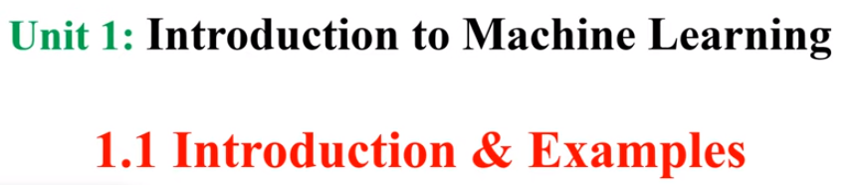

Slide 2
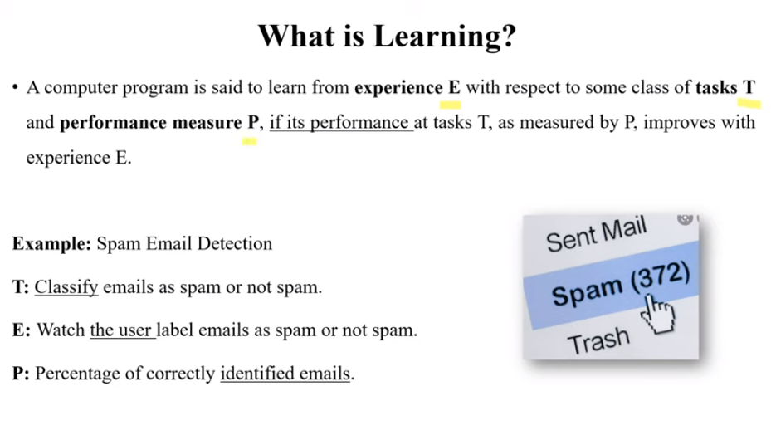

Slide 3
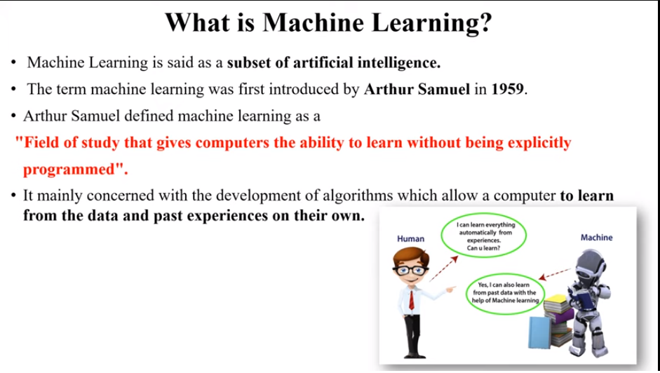

Slide 4
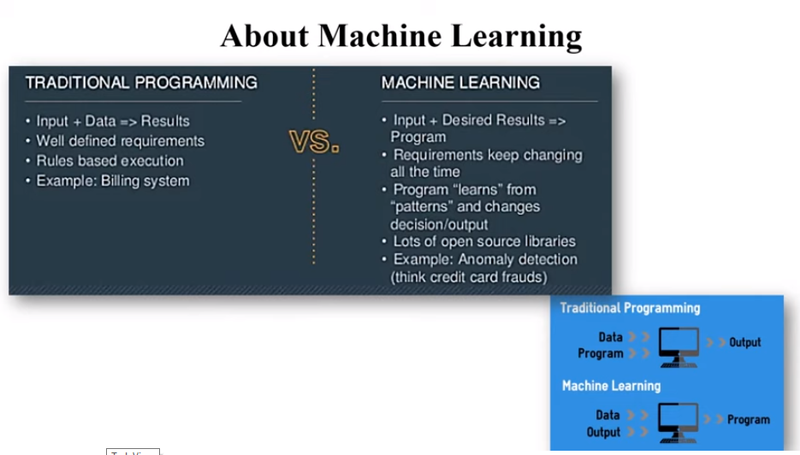

Slide 5
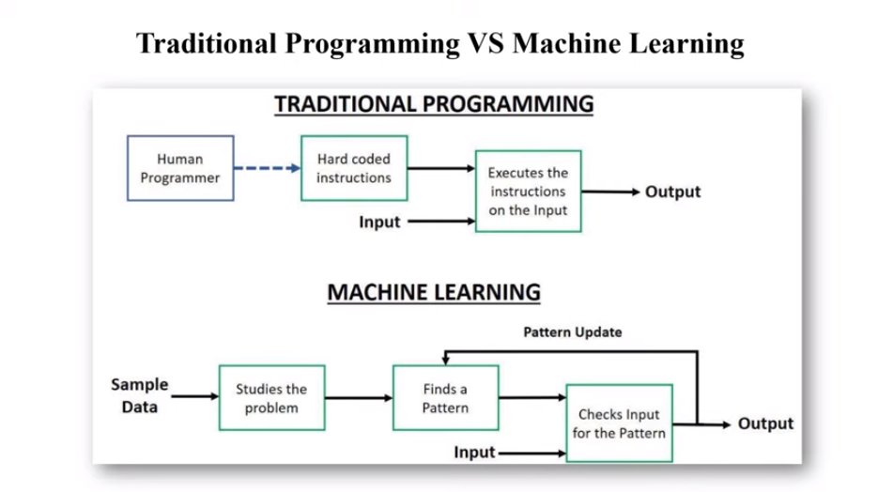

Slide 6
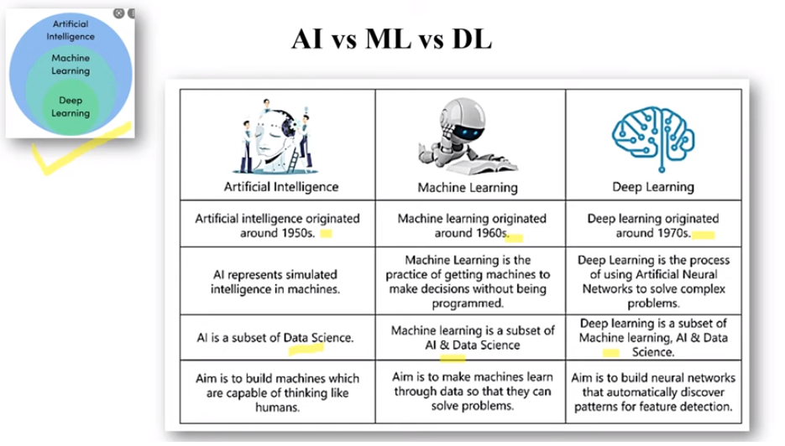

Slide 7
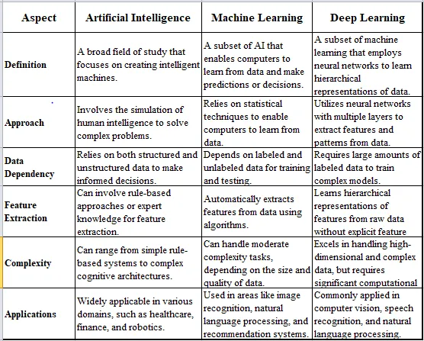

Slide 8
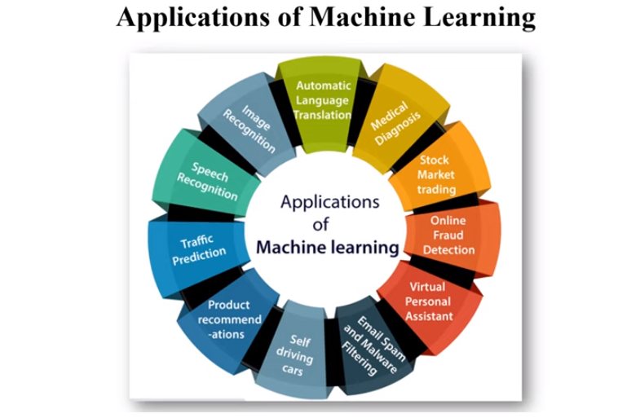

Slide 9
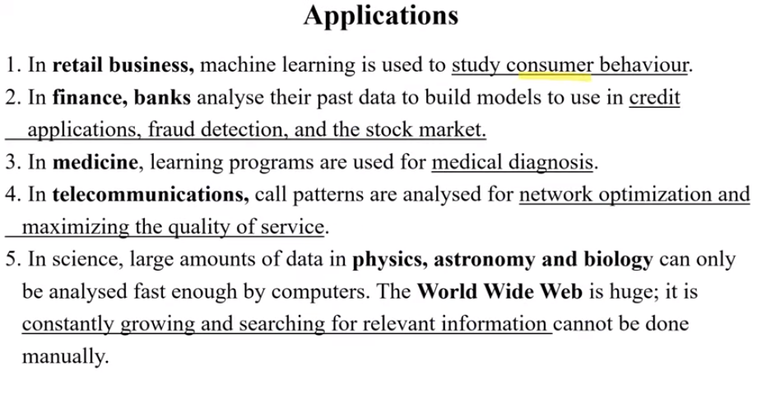

Slide 10


Slide 11
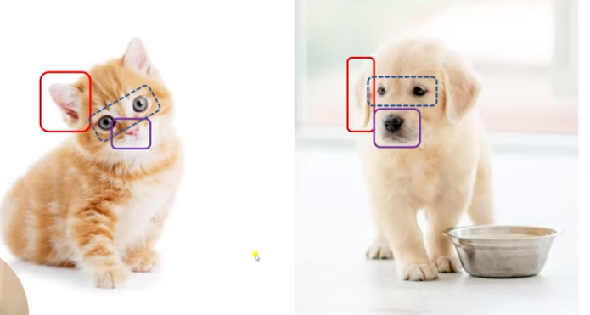
FEATURES

Slide 12
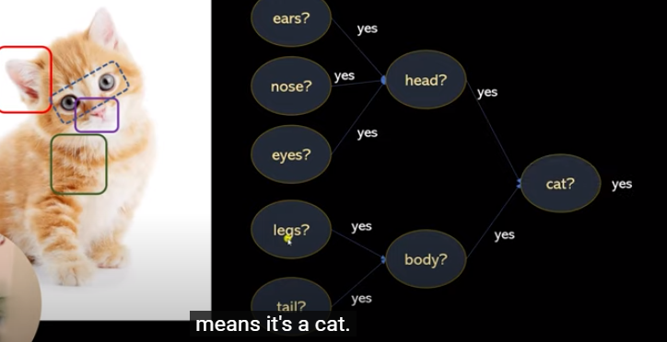

Slide 13
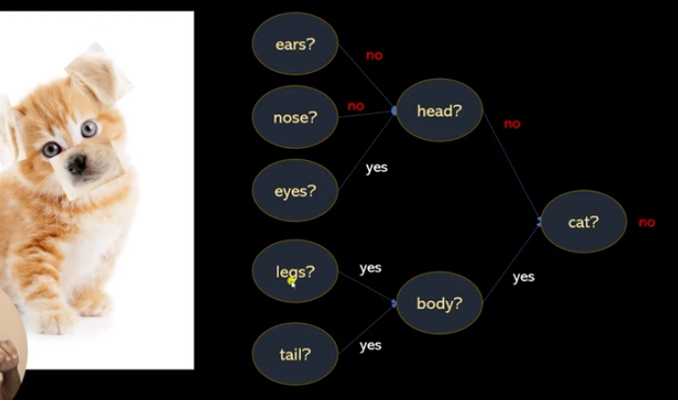

Slide 14
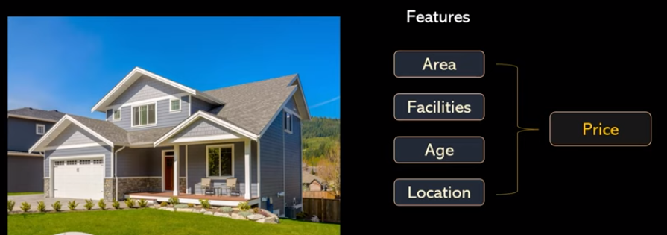

Slide 15
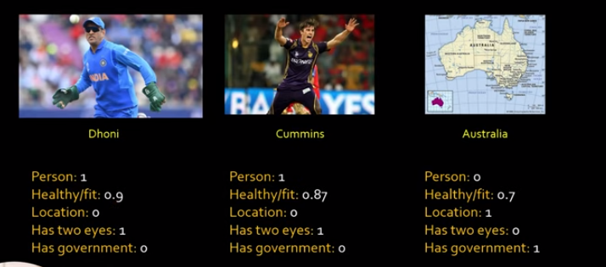

Slide 16
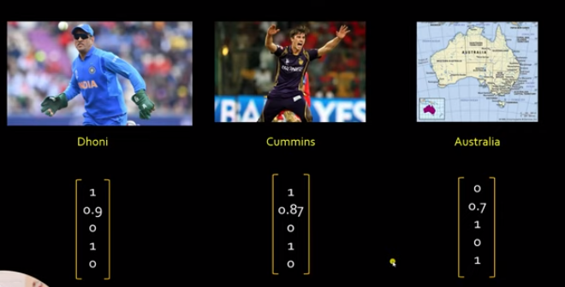

Slide 17
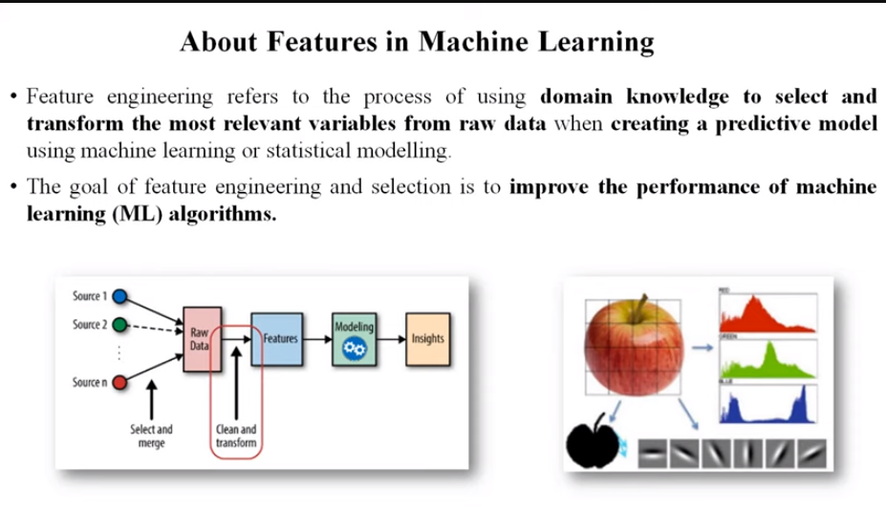

Slide 18
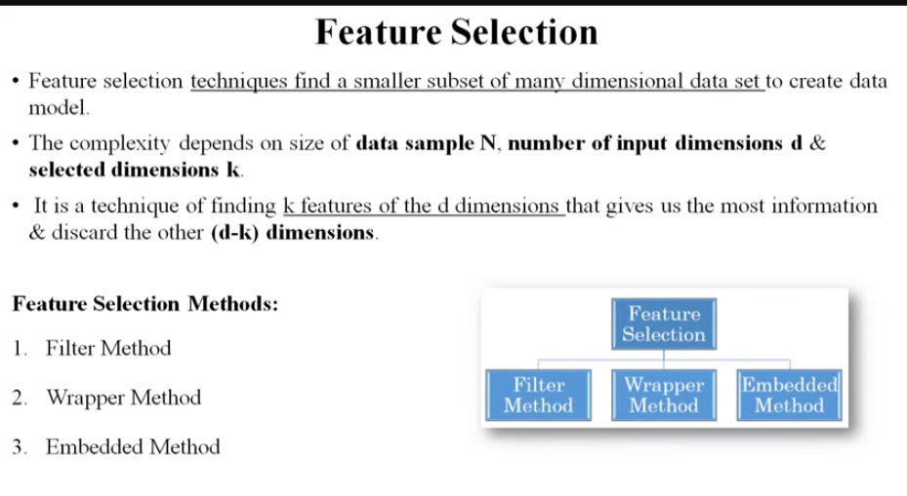

Slide 19
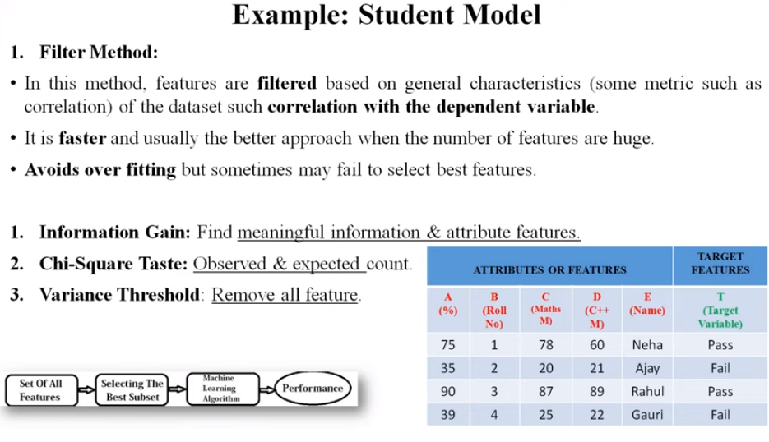

Slide 20
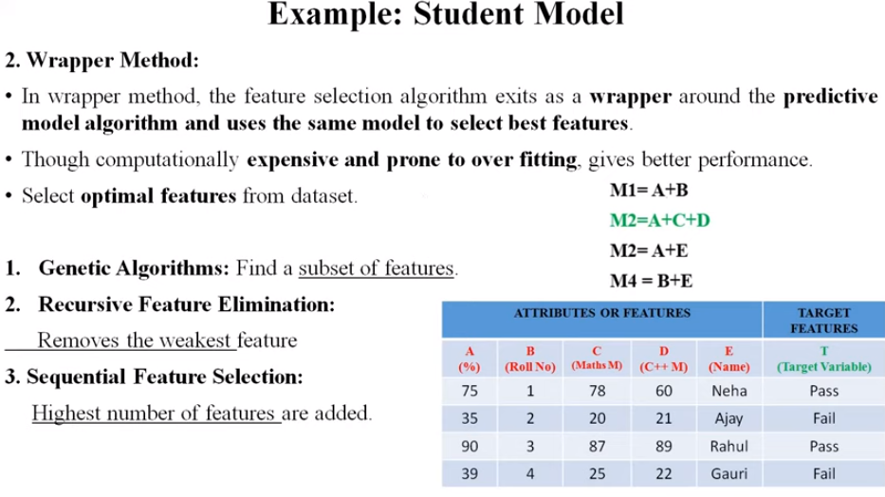

Slide 21
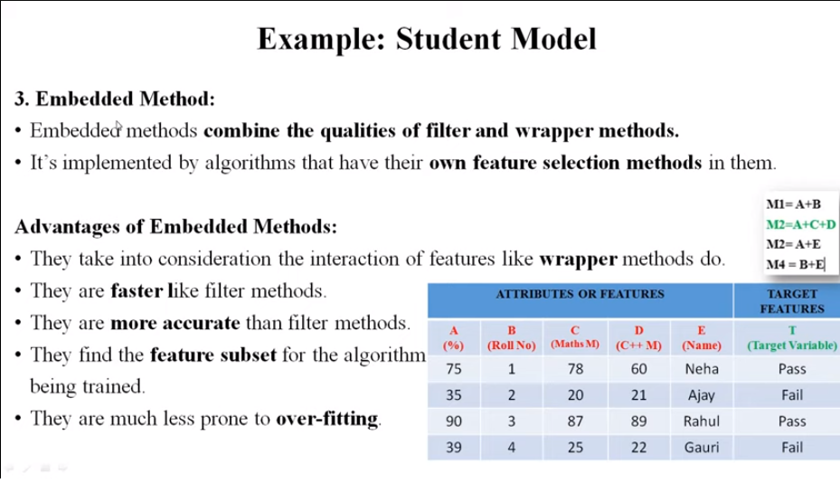

Slide 22
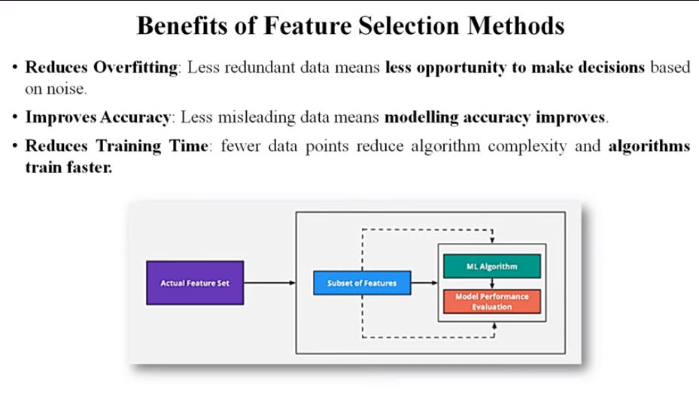

Slide 23
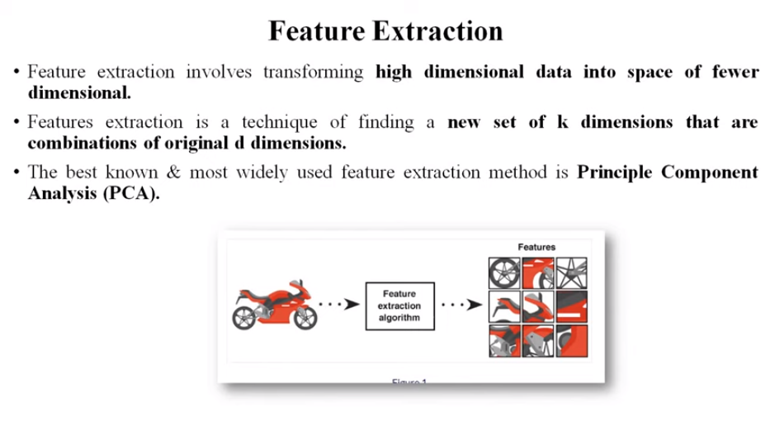

Slide 24
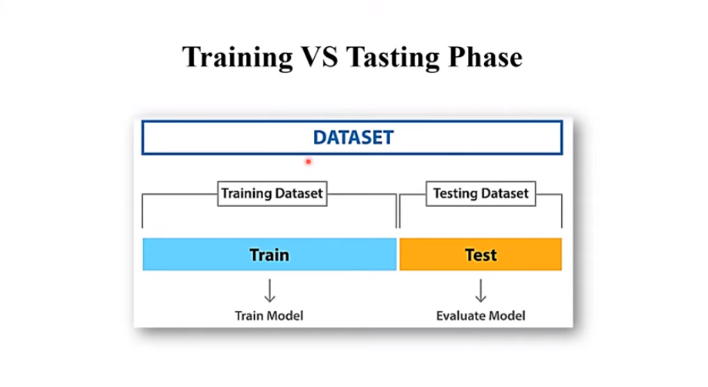

Slide 25
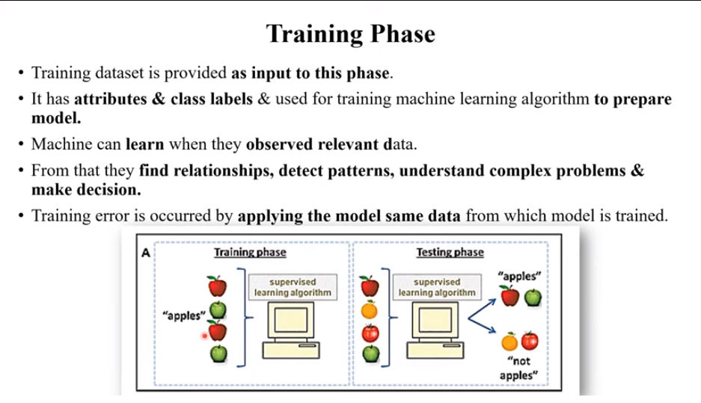

Slide 26
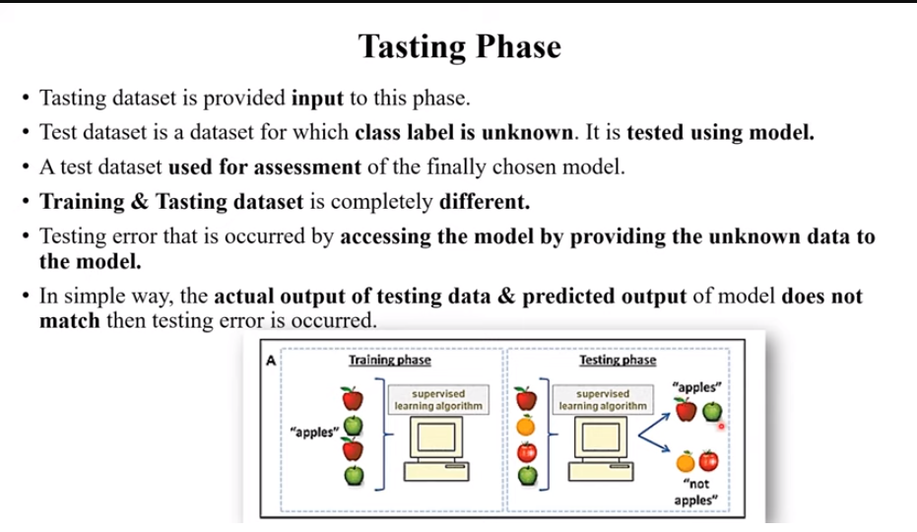

Slide 27
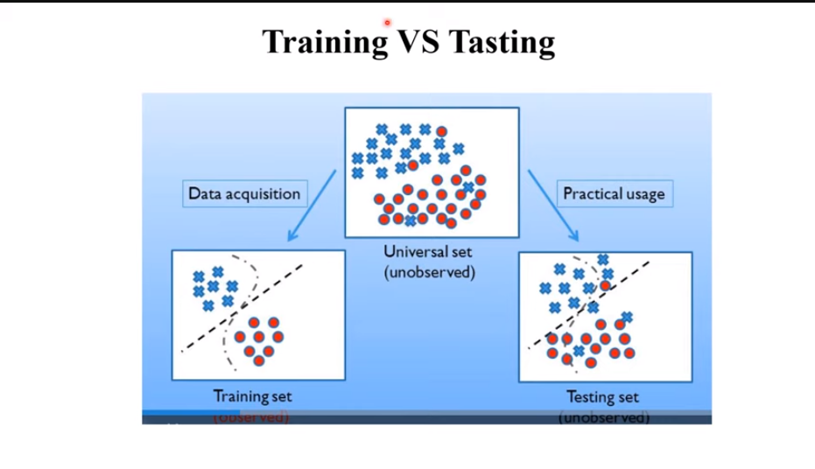

Slide 28
Here are the key steps involved in formulating a machine learning problem:
1. Define the problem: The first step is to clearly define the problem you want to solve. For example, you may want to predict the price of a house based on its location, size, and number of rooms.
2. Collect the data: The next step is to collect the data that will be used to train and test the machine learning model. This data should be representative of the problem you are trying to solve.
3. Prepare the data: The data collected may not be in the appropriate format for machine learning. Therefore, it may need to be preprocessed, which could include tasks such as cleaning, normalization, and feature engineering.

Slide 29
4. Choose the algorithm: After the data has been pre-processed, you need to select the appropriate algorithm to solve the problem. This may involve choosing from supervised, unsupervised, or reinforcement learning algorithms, depending on the type of data and the problem you are trying to solve.
5. Train the model: Once the algorithm has been chosen, the next step is to train the model using the prepared data.
6. Evaluate the model: After the model has been trained, it is important to evaluate its performance to determine how well it is solving the problem. This can be done by using evaluation metrics such as accuracy, precision, recall, and F1 score.
7. Deploy the model: Once the model has been trained and evaluated, it can be deployed to make predictions on new, unseen data

Slide 30
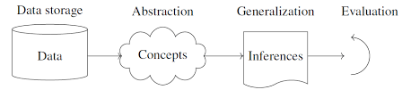
Components of learning process

Slide 31
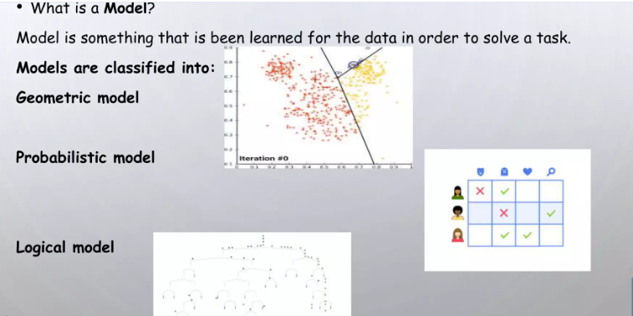
MACHINE LEARNING MODELS

Slide 32
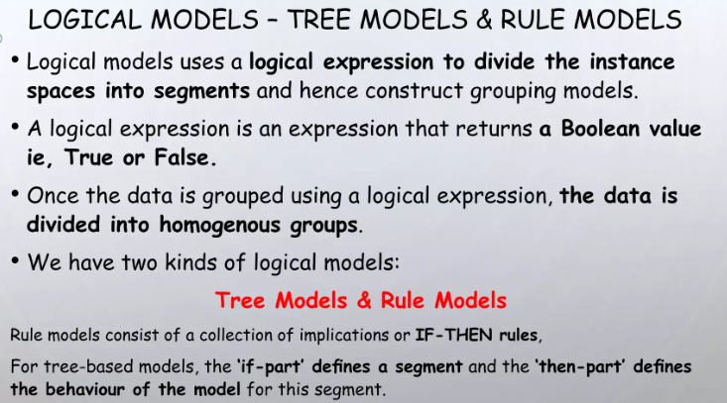

Slide 33
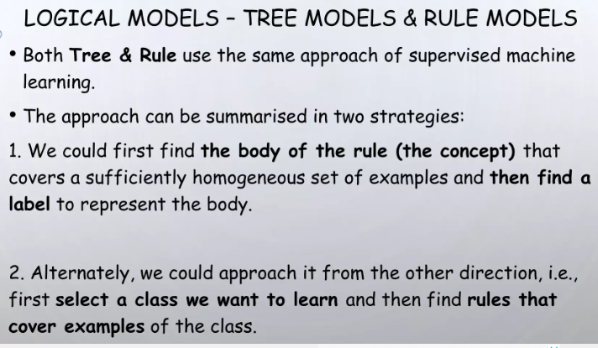

Slide 34
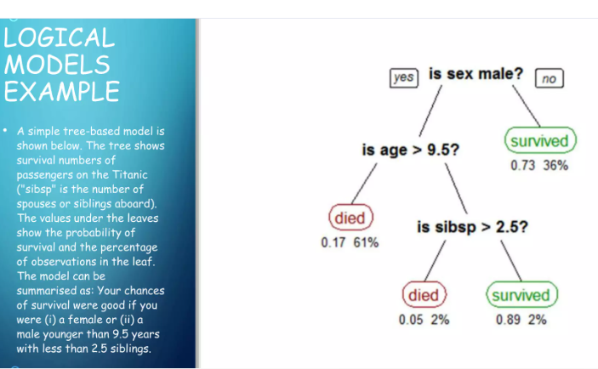

Slide 35
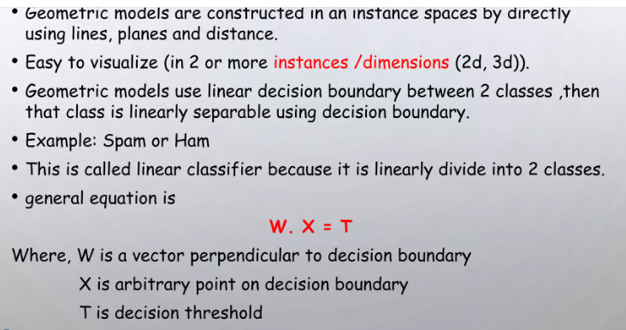

Slide 36
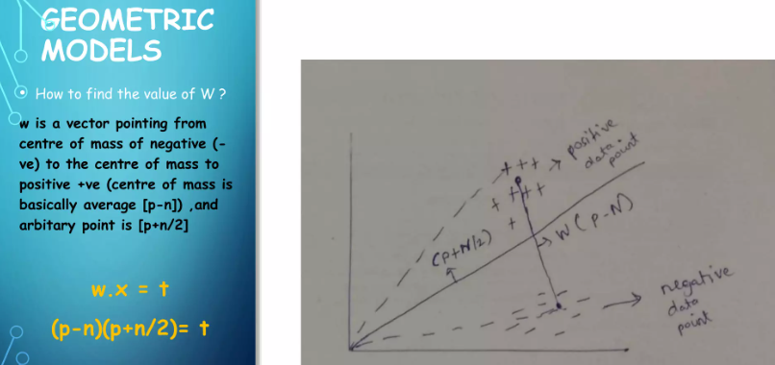

Slide 37
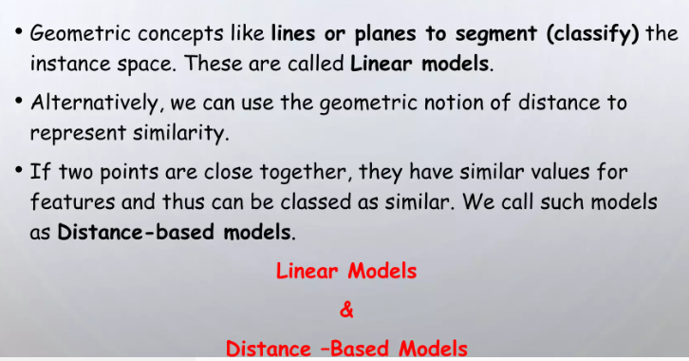

Slide 38
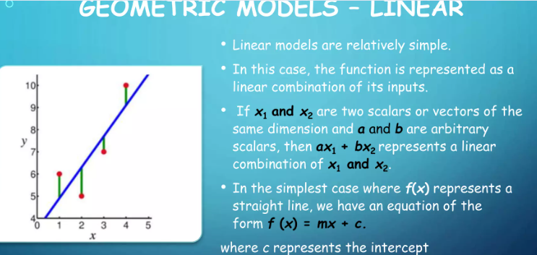
m represents the slope

Slide 39
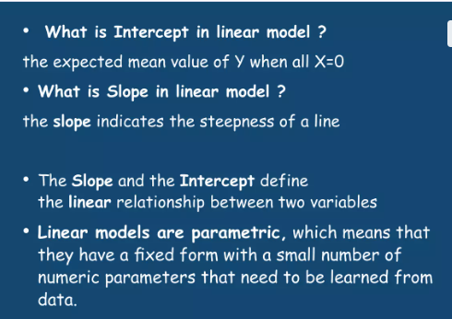
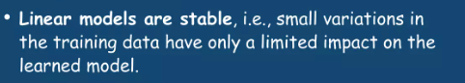

Slide 40
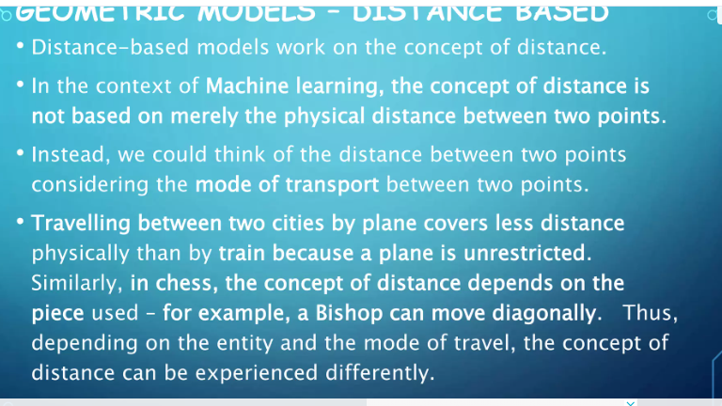

Slide 41
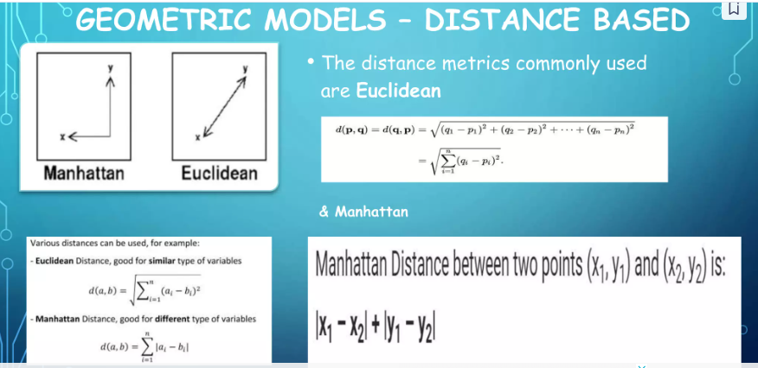

Slide 42
https://www.slideshare.net/slideshow/machine-learning-unit-1-semester-3-msc-it-part-2-mumbai-university/246962512

Slide 43
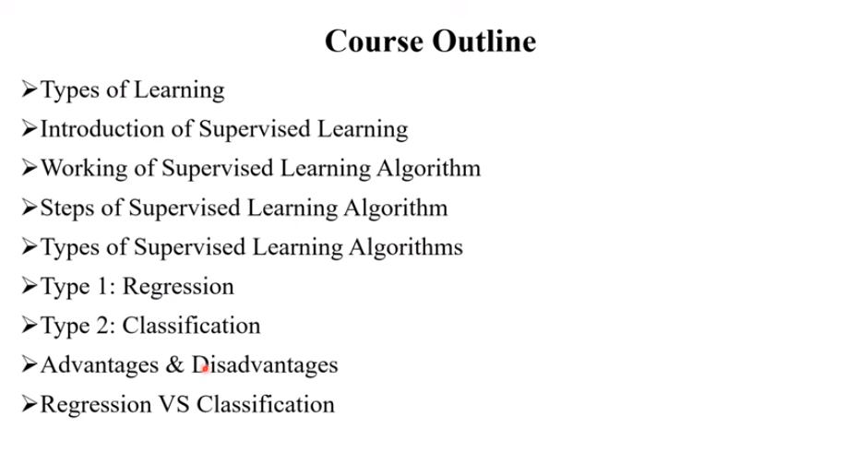

Slide 44
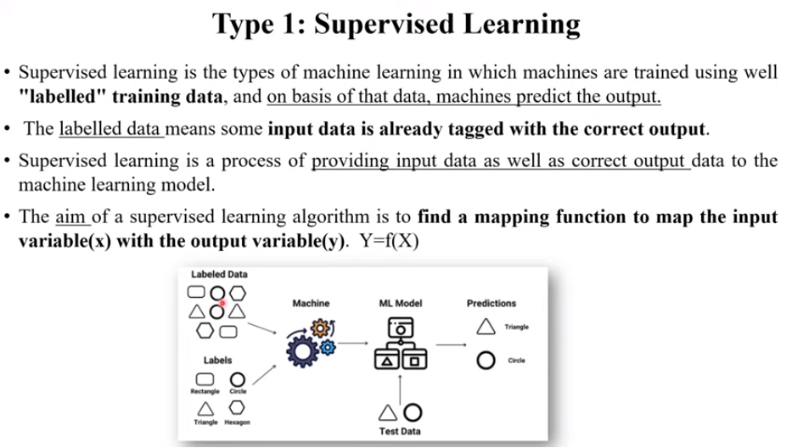

Slide 45
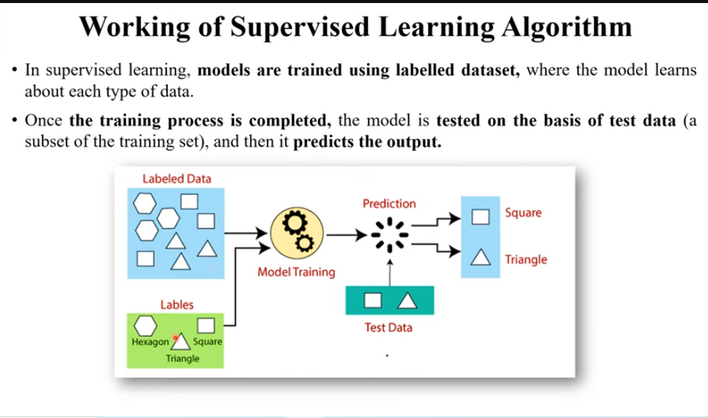

Slide 46
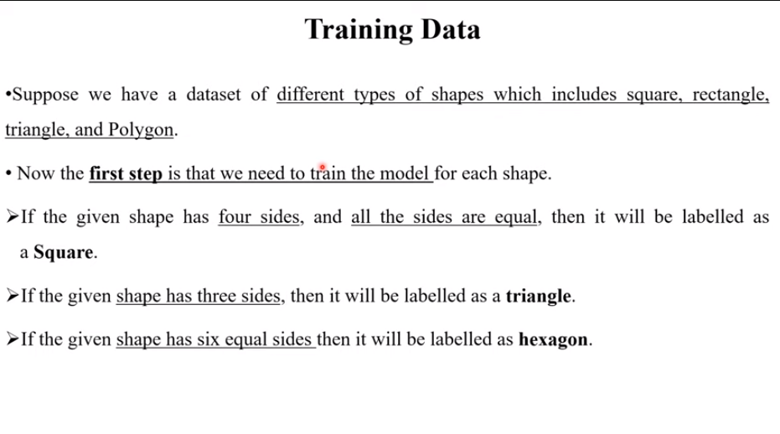

Slide 47
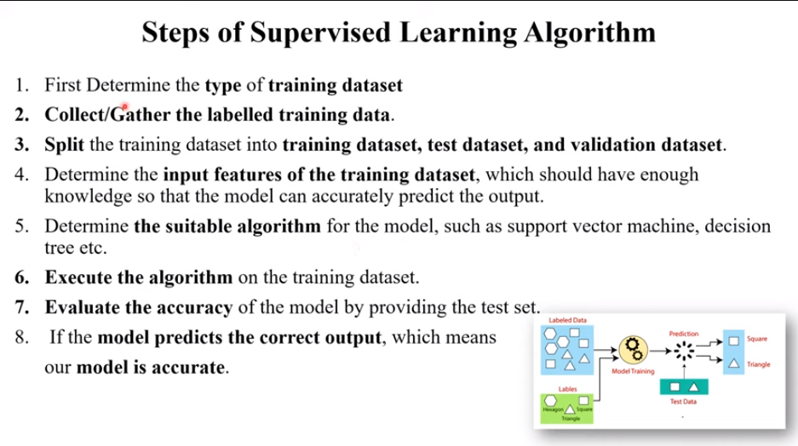

Slide 48
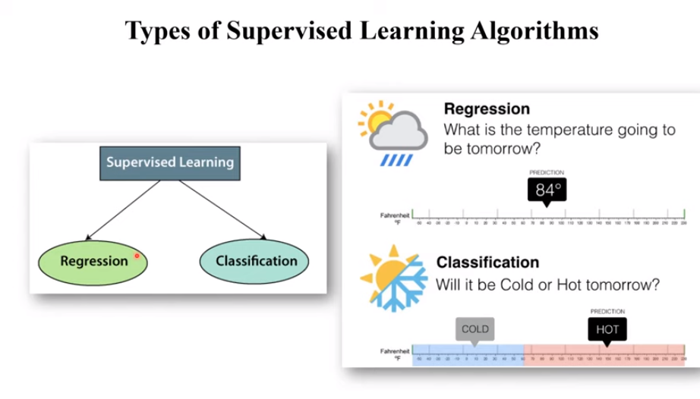

Slide 49
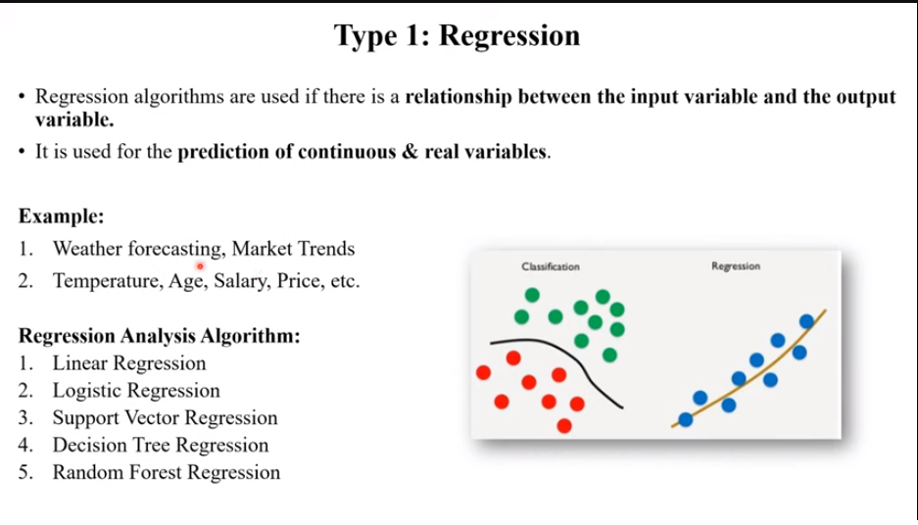

Slide 50
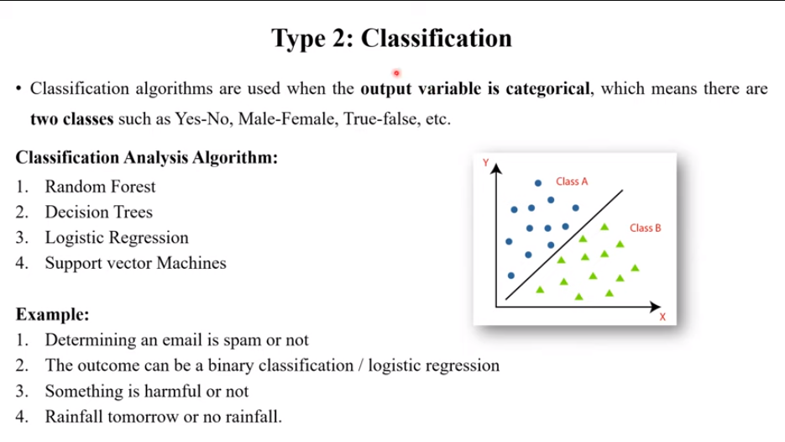

Slide 51
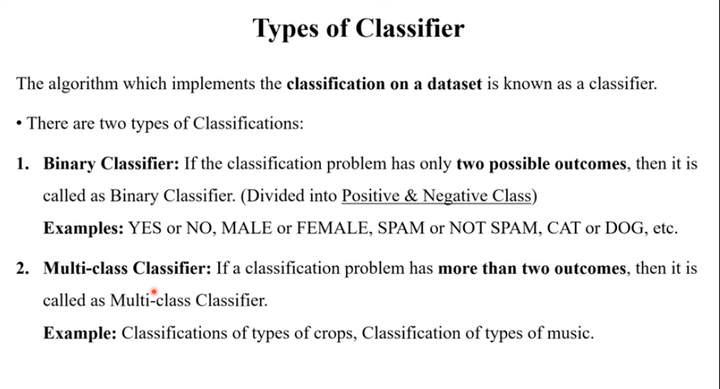

Slide 52
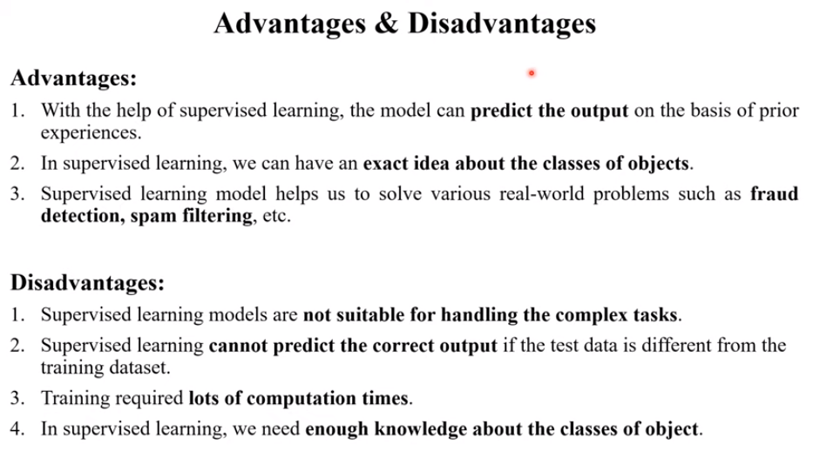

Slide 53
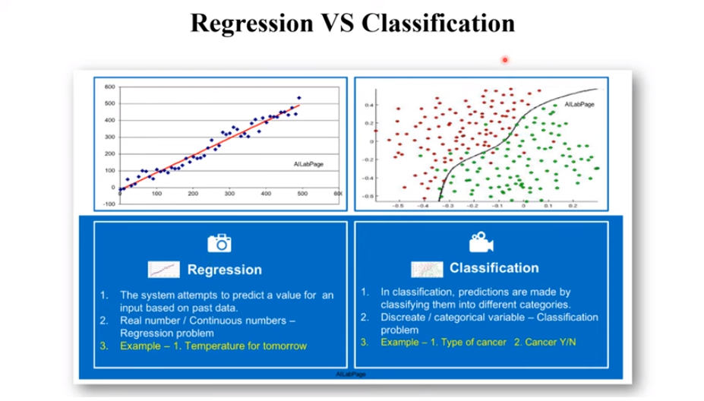

Slide 54


Slide 55


Slide 56


Slide 57


Slide 58


Slide 59


Slide 60


Slide 61


Slide 62


Slide 63


Slide 64


Slide 65


Slide 66


Slide 67


Slide 68


Slide 69


Slide 70


Slide 71


Slide 72


Slide 73


Slide 74


Slide 75


